Slide 1

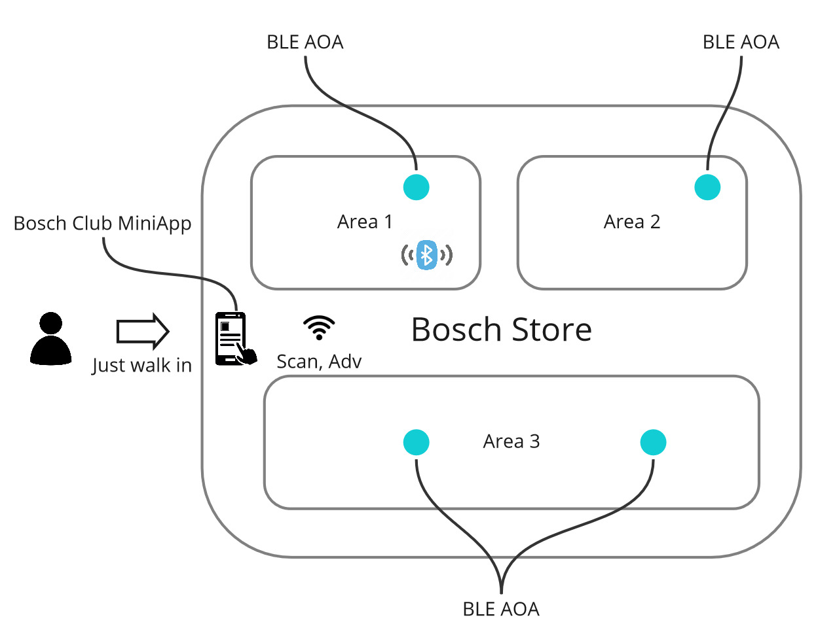
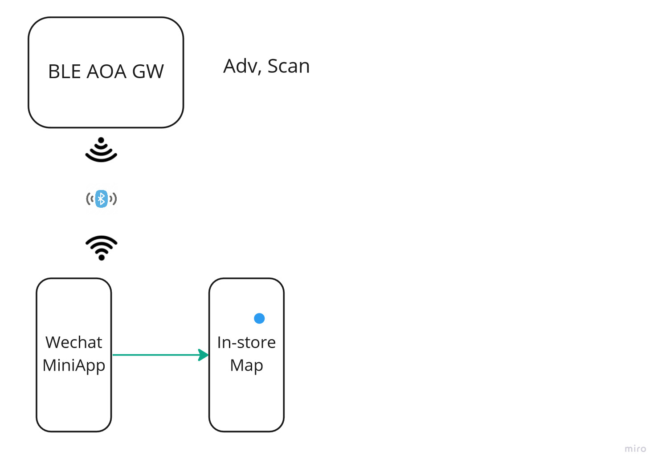
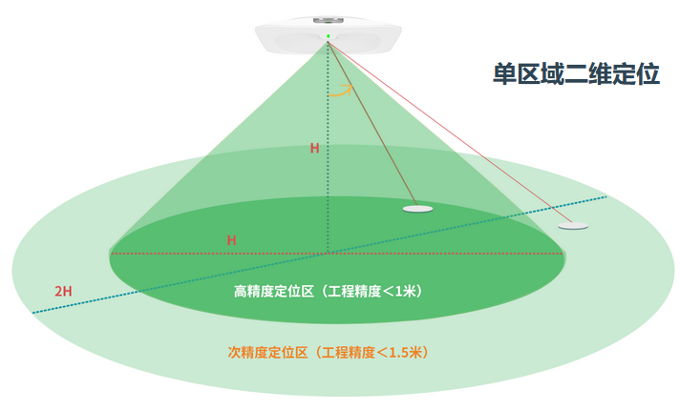
POC – BLE AOA
Statement of requirement for POC
Server
Customer_id, (timestamp, (x,y)) …

Slide 2


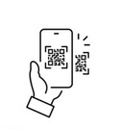





POC – User Interaction
Statement of requirement for POC
In-Store
BLE Beacon
Digital content
Touch point
User Interaction

Slide 3

POC – WeChat mini program
Statement of requirement for POC
In-Store
BLE Beacon
Digital content
Customer_id, (timestamp, (x,y)) …
微信小程序

Slide 4
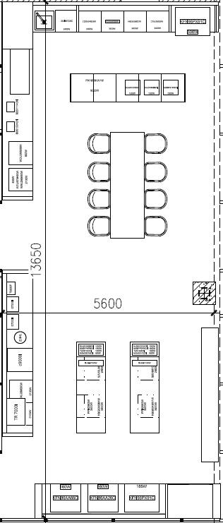
POC – Web portal
Statement of requirement for POC
Map
Data log:
Timestamp, ID_001, (x,y), Scanning QR of xx
Timestamp, ID_001, (x,y)
Timestamp, ID_001, (x,y)
Timestamp, ID_002, (x,y), Scanning NFC of xx
Timestamp, ID_002, (x,y)
Timestamp, ID_001, (x,y)
Timestamp, ID_002, (x,y)
Timestamp, ID_001, (x,y)
Timestamp, ID_003, (x,y), Scanning QR of xx
Timestamp, ID_003, (x,y)
Timestamp, ID_001, (x,y)
Timestamp, ID_002, (x,y)
…
Web portal

Slide 5
POC – frontend mockup
Statement of requirement for POC
TBD

